Slide 1




Hackathon 26
Problem Statement ID – 02
Problem Statement Title- Generative AI for Supply Chain Management
PS Category- Software
Team Name- SheCodes!
Team Leader Name(With Contact Number) –Riddhi Awasthi(7058673034)

Slide 2


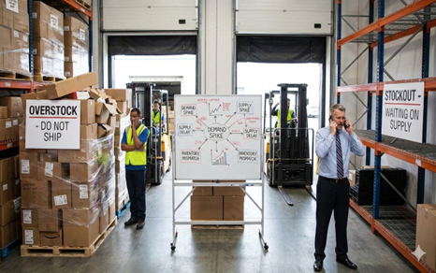
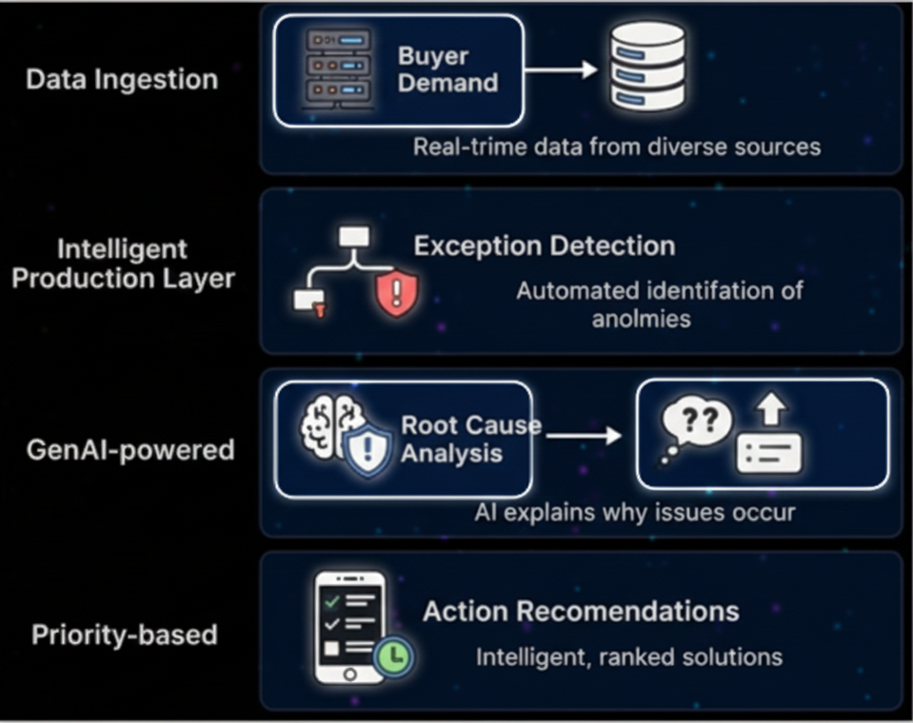
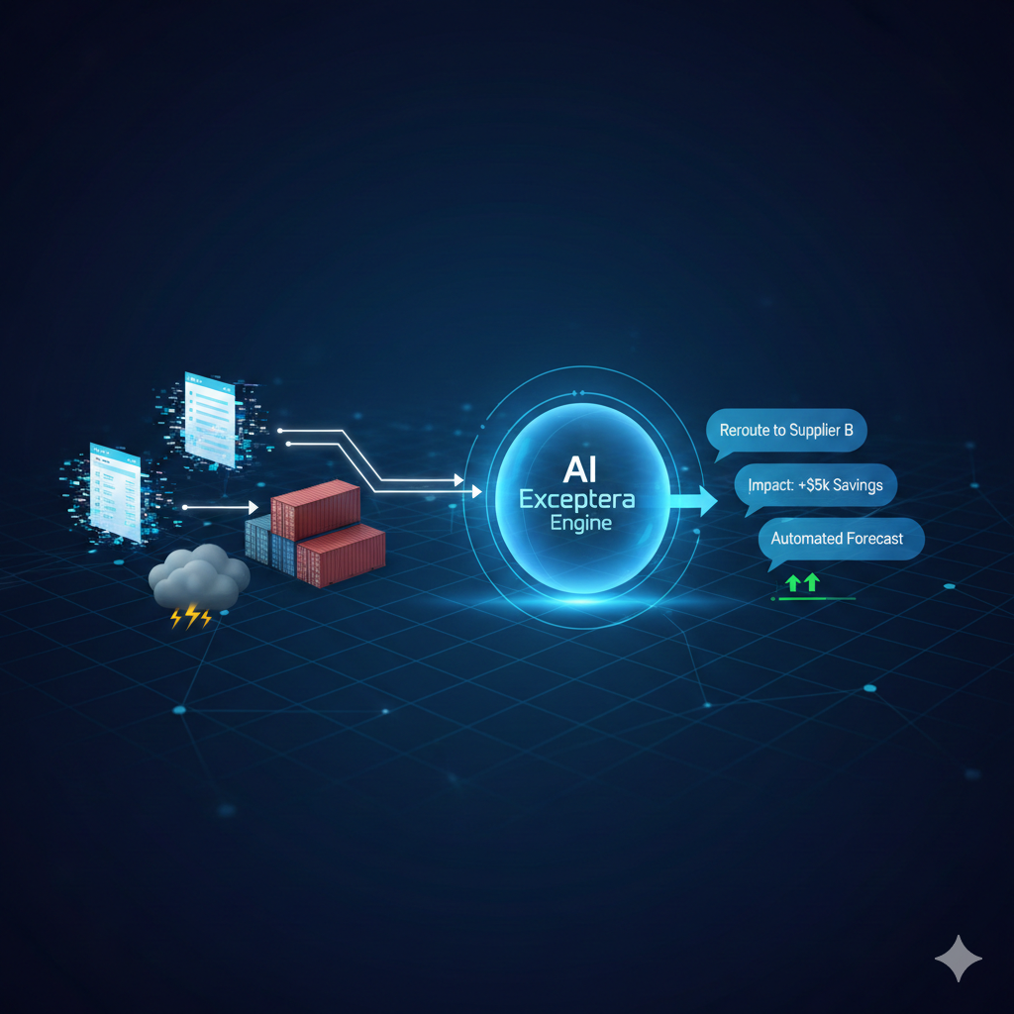
IDEA TITLE
SheCodes!
PROBLEM FACED:
PROPOSED SOLUTION:
The Insight Gap: ERPs show "What" (Out of Stock), but never "Why" or "What’s Next."
Alert Fatigue: Endless "Red Flags" with zero prioritization create Decision Paralysis.
Manual Silos: Humans must hunt for data across spreadsheets and emails to solve a single delay.
• Centralized inventory exception management system
• Detects stockouts, overstock & supplier delays in real time
• Uses Generative AI to explain each alert in simple language
• Provides clear, actionable recommendations (what to do next)
How it works:
Advantages of Exceptra:
Explains the backstory of every inventory failure.
Connects local stock levels to global events.
Predicts "What-If" outcomes for different decisions.
Directs human attention to the most expensive fires first.
MARKET VALIDATION & INDUSTRY EVIDENCE:
• McKinsey reports 20–30% revenue loss due to supply chain disruptions
• Gartner finds 70% of inventory alerts are ignored due to lack of explanation
PRPCEM HACKATHON' 26

Slide 3




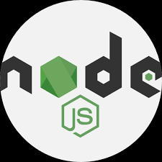

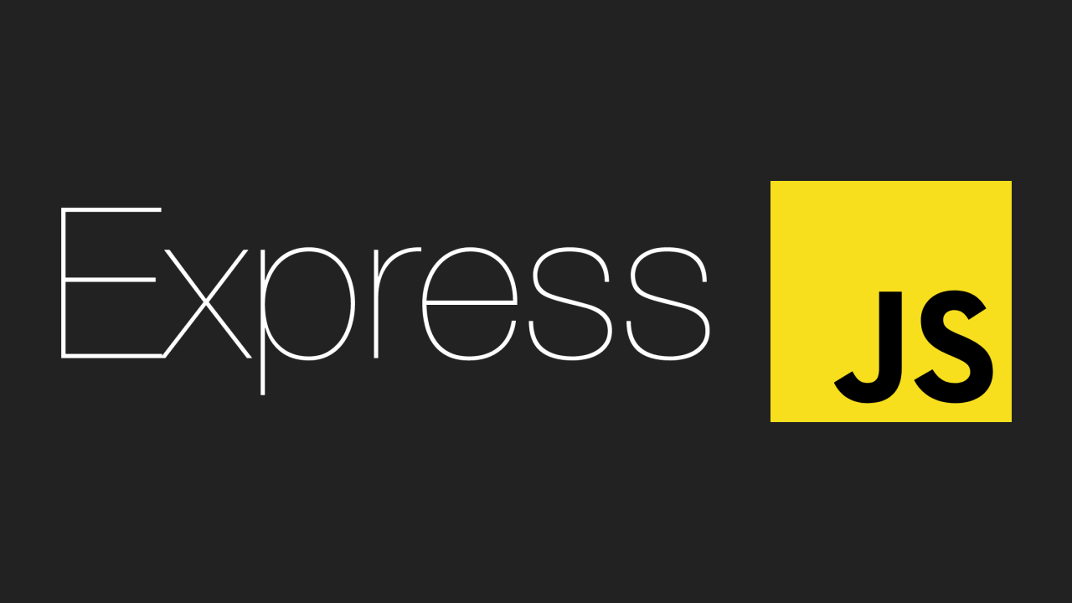



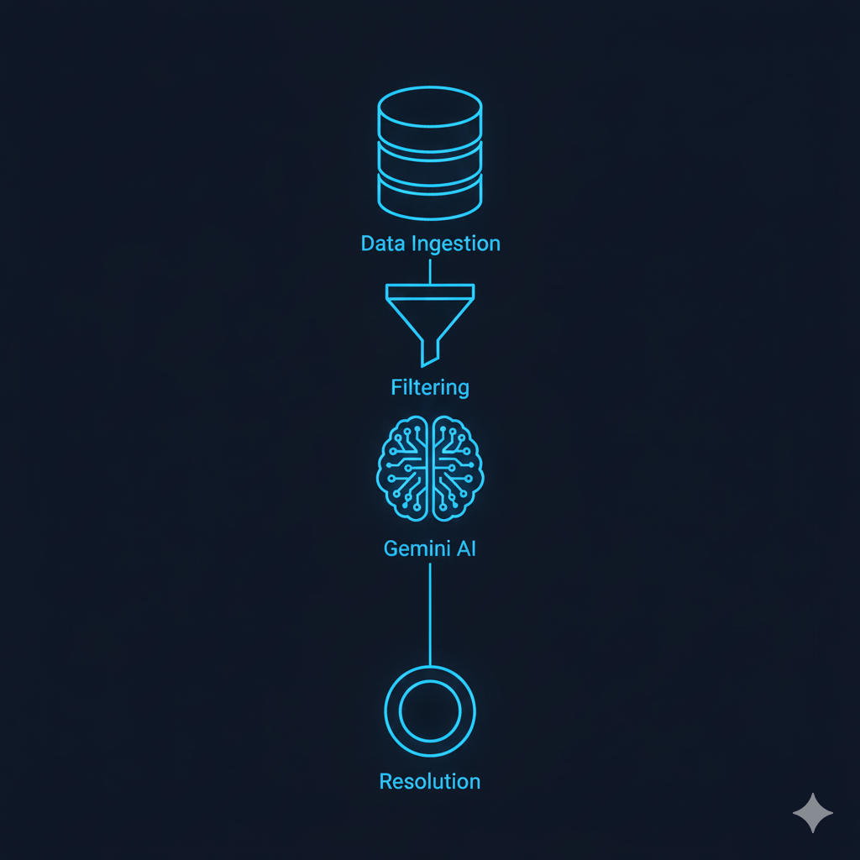
TECHNICAL APPROACH
SheCodes!
TECHNOLOGIES
METHODOLOGY AND PROCESS
Frontend -
Backend -
Databases -
API-
1. Data Synthesis: Merging internal logs with real-time external streams (News/Weather) into a unified context.
2. Exception Mapping: Applying hard-coded rules to filter "noise" and isolate high-impact supply chain failures.
3. Contextual Reasoning: Gemini uses RAG to cross-reference anomalies with live events to find the "Why."
4. Strategic Resolution: Converting AI insights into one-click, structured "Exit Strategies" for managers.
SYSTEM ARCHITECTURE FLOW
KEY ARCHITECTURE HIGHLIGHTS
1. Ingestion: Merges ERP Data (Postgres/CSV) with External Signals (News/Weather APIs) via Node.js.
2. Filtering: Hard-coded Deterministic Rules trigger alerts only for critical "Exceptions" to eliminate noise.
3. Reasoning: Google Gemini + RAG analyzes the alert against global context to identify the Root Cause.
4. Resolution: Next.js Dashboard delivers a natural language brief with a One-Click Action fix.
Semantic Ingestion: Converts raw data into "context-aware" tokens for AI reasoning.
Deterministic Logic: Uses hard-coded rules to flag critical failures (e.g., Stock < 5%) with 100% accuracy.
Generative Root-Cause: Gemini synthesizes the "Anomaly" with global context (News/Weather) to explain the "Why."
Agentic Action: Outputs structured, one-click fixes (e.g., "Trigger Backup Supplier") for immediate resolution.
PRPCEM HACKATHON' 26

Slide 4


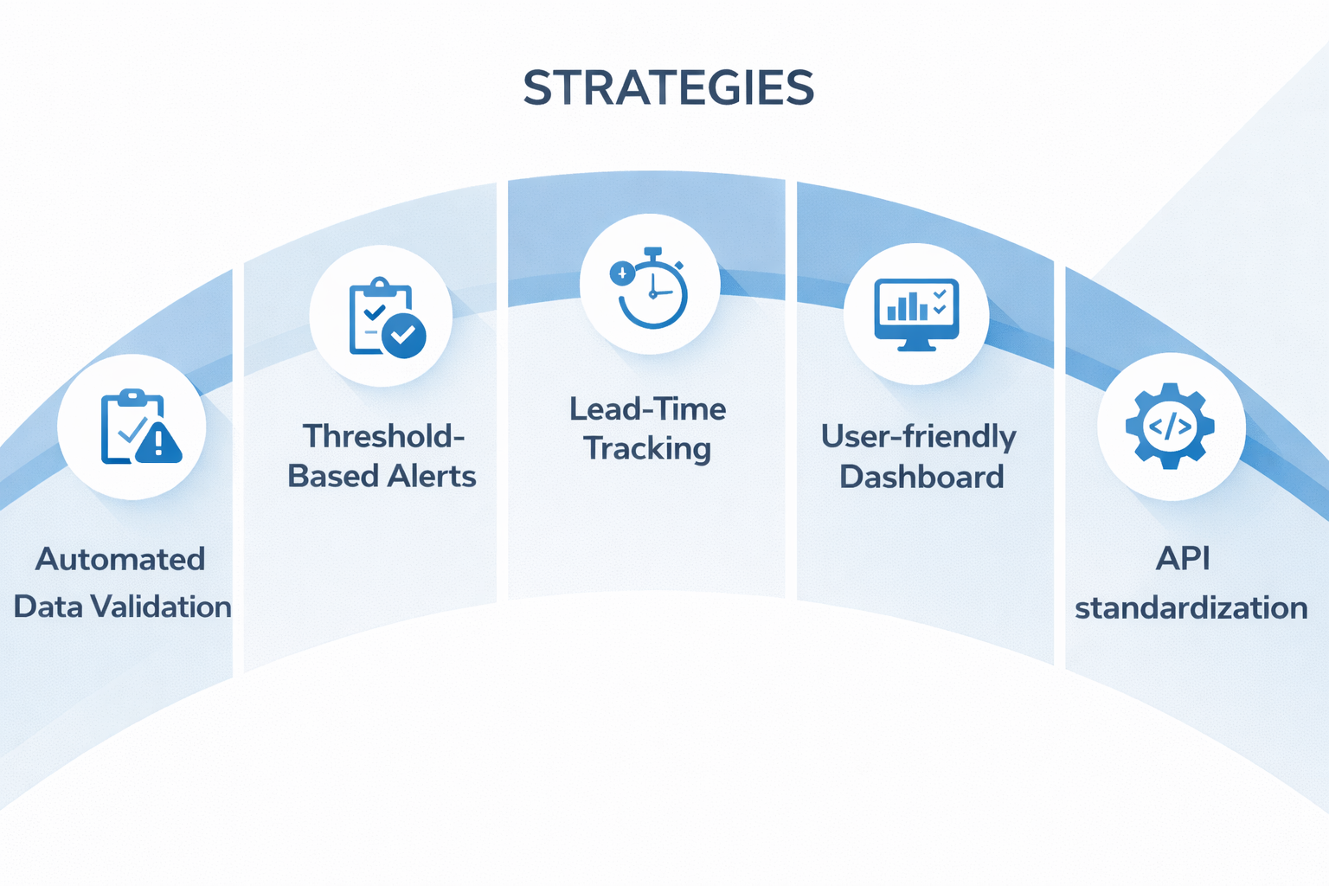
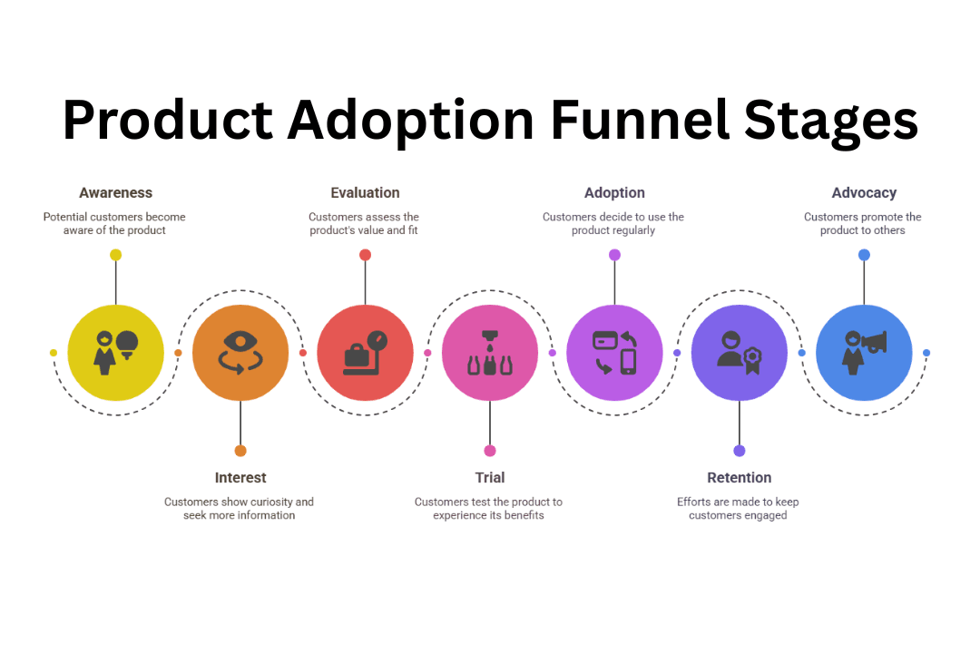

FEASIBILITY AND VIABILITY
SheCodes!
FEASIBILITY:
VIABILITY:
STRATEGIES:​
Technical Feasibility
Proven web technologies
Rule-based, transparent logic
API-driven ERP integration
Operational Feasibility
Uses existing inventory data
Centralized monitoring dashboard
Minimal training required
Economic Feasibility
Reduces stockout & overstock losses
Low development and deployment cost
High return on investment
Scalability Feasibility
Modular, horizontally scalable design
Suitable for SMEs and enterprises
Market Viability
Applicable across retailers, wholesalers, and manufacturers
Addresses a common and recurring supply chain problem
Adoption Viability
Simple, role-based dashboard
No hardware dependency
Easy onboarding with minimal training
Scalability Viability
Modular architecture supports growth
Scales across products, locations, and users
Automated data validation and consistency checks
Safety stock and threshold-based alerting
Lead-time monitoring with early delay alerts
Simple, intuitive UI to improve user adoption
Standardized APIs for smooth system integration
CHALLENGES AND RISKS:​
Data inaccuracies and delays
Demand volatility and spikes
Unreliable supplier lead times
User adoption resistance
Integration across multiple systems
PRPCEM HACKATHON' 26

Slide 5

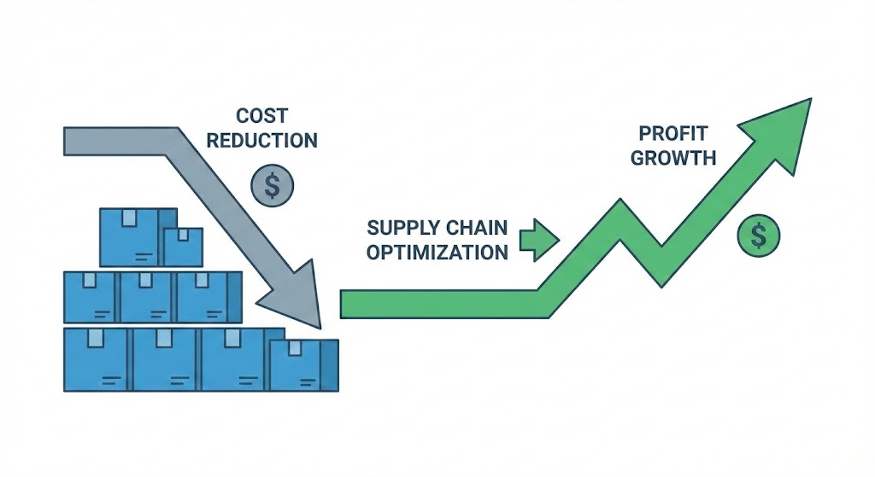
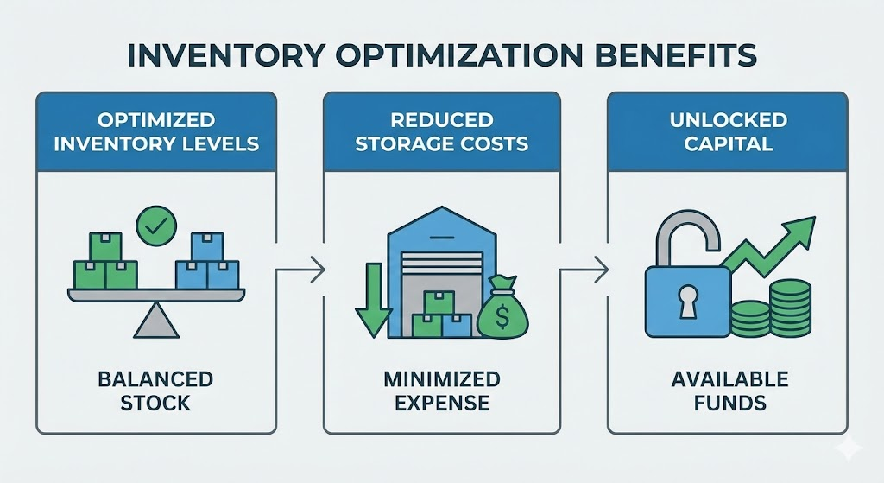
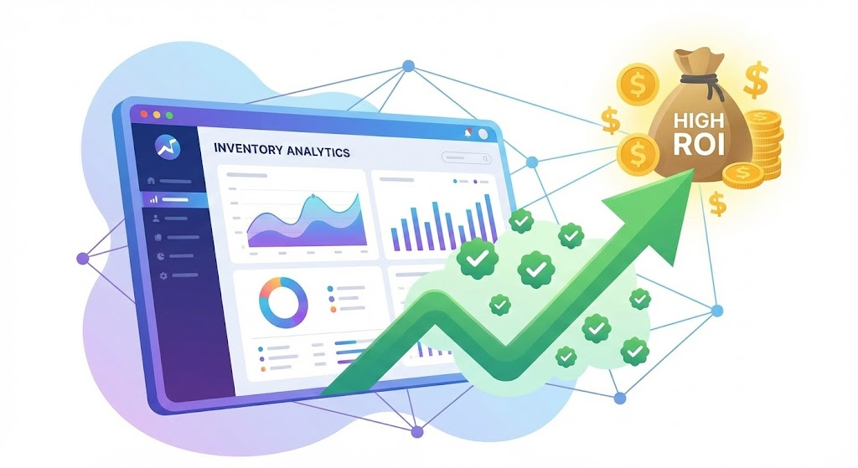
IMPACT AND BENEFITS
SheCodes!
IMPACT ON STAKEHOLDERS
ON RETAILERS
ON MANUFACTURERS
ON WHOLESALERS
Reduced stockouts and improved product availability
Faster response to demand spikes and sales events
Better store-level inventory visibility
Balanced inventory across multiple retailers
Improved coordination with manufacturers
Reduced excess stock and holding costs
Clear demand signals from downstream partners
Better production planning and scheduling
Reduced last-minute changes and disruptions
BENEFITS
Economic Benefit
Operational Benefit
Systemic Benefit
Lower revenue loss due to stockouts
Reduced capital blockage from excess inventory
Improved profitability through optimized inventory decisions
Real-time inventory visibility across the supply chain
Faster exception detection and resolution
Reduced manual monitoring and reporting effort
Improved coordination between supply chain partners
More resilient and responsive supply chain operations
Scalable digital foundation for future AI-driven optimization
PRPCEM HACKATHON' 26

Slide 6

WHAT'S NEXT
SheCodes!
➤ Action:
Finalize inventory data model & SKU structure
Set reorder levels, safety stock & exception rules
➤ Backend:
Build REST APIs for inventory ingestion
Implement exception detection logic (stockout, overstock, delay)
➤ Testing:
Validate system using sample inventory datasets
Test alert generation & severity classification
➤ Enhancement:
Add demand trend analysis & forecasting logic
Improve alert accuracy using historical data
➤ Scalability:
Cloud deployment with modular services
Support for multiple locations & users
➤ Business Readiness:
Role-based access control
Reporting & export features for managers
Before Hackathon
At Hackathon
After Hackathon
➤ Dashboard:
Centralized inventory dashboard (React-based)
Live alerts for stockouts & overstock
➤ Decision Support:
Action recommendations linked to each alert
Priority-based exception highlighting
➤ Demo Flow:
End-to-end data → exception → decision demo
Multi-stakeholder inventory scenario showcase
PRPCEM HACKATHON' 25

Slide 7

RESEARCH AND REFERENCES
SheCodes!
Links:
https://ai.google.dev/api
https://docs.cloud.google.com/docs/generative-ai
https://www.mckinsey.com/capabilities/quantumblack/our-insights/the-state-of-ai
https://www.gartner.com/en/newsroom/press-releases/2025-03-18-gartner-identifies-top-supply-chain-technology-trends-for-2025
https://github.com/iriddhi11/Exceptra.git
GitHub Repository Link:
PRPCEM HACKATHON' 26

